Slide 1

CSE 350 Digital Electronics and Pulse Techniques
Signal Generator:
Square Wave and Triangular Wave
Course Instructor: Shomen Kundu (SDU)
Mail: shomen.kundu@bracu.ac.bd
Desk: 4N139

Slide 2
Signal Generator
We will study two types of signal generator
Square wave generator
Triangular wave generator

Slide 3
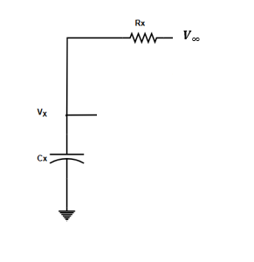
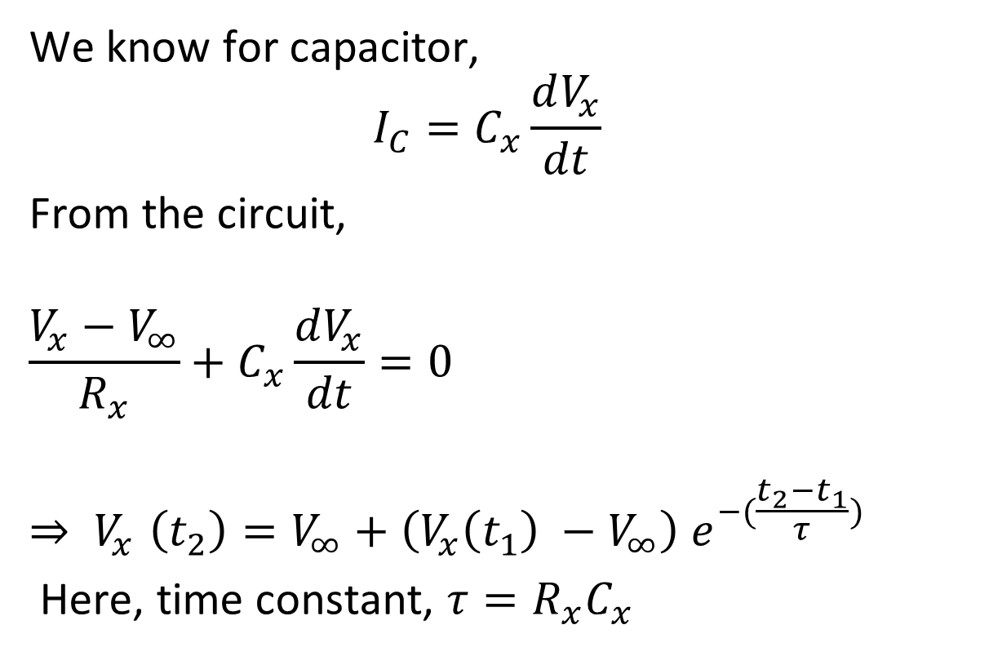
Basic RC circuit
We know for capacitor,
$$I_{C}=C_{x}\frac{dV_{x}}{dt}$$
From the circuit,
$$\frac{V_{x}−V_{∞}}{R_{x}}+C_{x}\frac{dV_{x}}{dt}=0$$
$${⇒ V}_{x}\left(t_{2}\right)=V_{∞}+\left(V_{x}\left(t_{1}\right) −V_{∞}\right) e^{−(\frac{t_{2}−t_{1}}{τ})}$$
Here, time constant, $τ=R_{x}C_{x}$

Slide 4

Basic RC circuit
If $t_{1}=0,t_{2}=t, τ=R_{x}C_{x}$
we can simply use this form,
$${ V}_{x}\left(t\right)=V_{x}\left(∞\right)+\left(V_{x}\left(0\right) −V_{x}(∞)\right) e^{−\frac{t}{τ}}$$

Slide 5
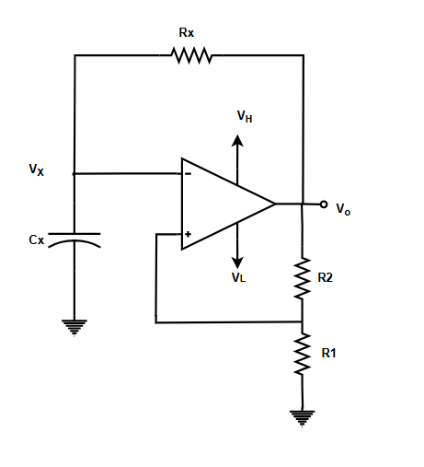
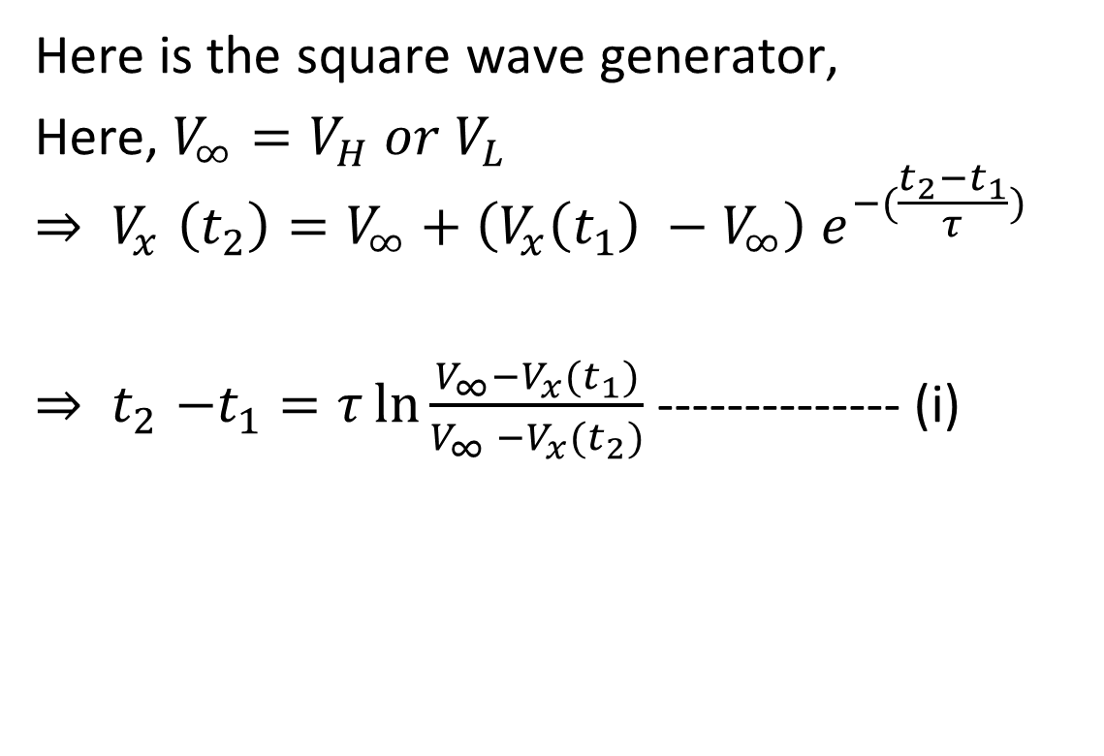
Square wave generator
Here is the square wave generator,
Here, $V_{∞}=V_{H} or V_{L}$
$${⇒ V}_{x}\left(t_{2}\right)=V_{∞}+\left(V_{x}\left(t_{1}\right) −V_{∞}\right) e^{−(\frac{t_{2}−t_{1}}{τ})}$$
${⇒ t}_{2}−t_{1}=τ\ln{\frac{V_{∞}−V_{x}(t_{1})}{V_{∞} −V_{x}(t_{2})}}$ -------------- (i)

Slide 6
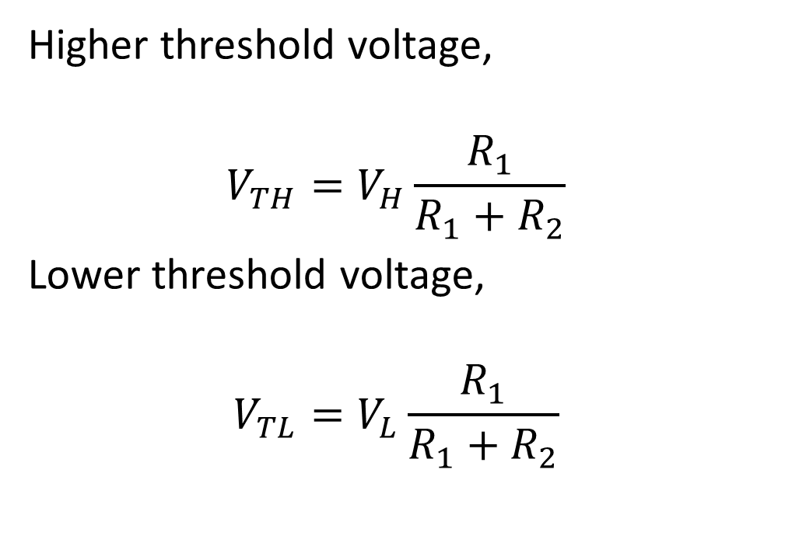
Square wave generator
Higher threshold voltage,
$$V_{TH}=V_{H}\frac{R_{1}}{R_{1}+R_{2}}$$
Lower threshold voltage,
$$V_{TL}=V_{L}\frac{R_{1}}{R_{1}+R_{2}}$$

Slide 7
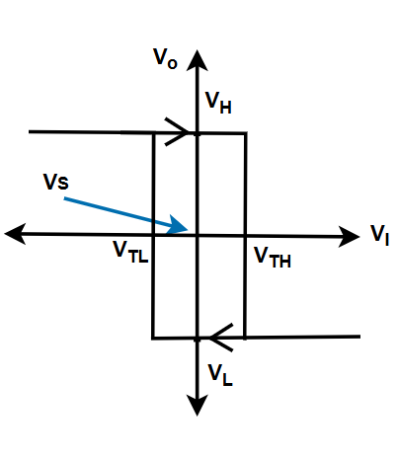
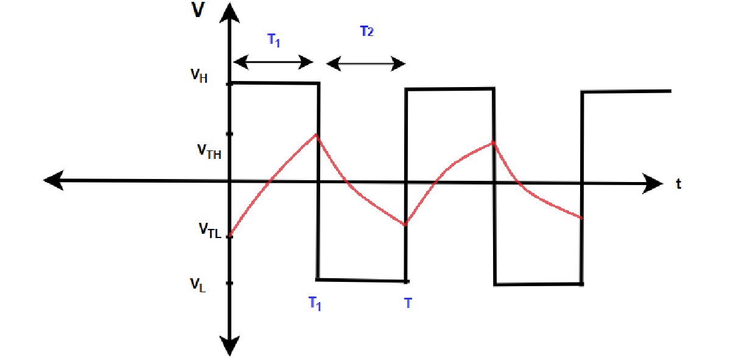
Square wave generator

Slide 8
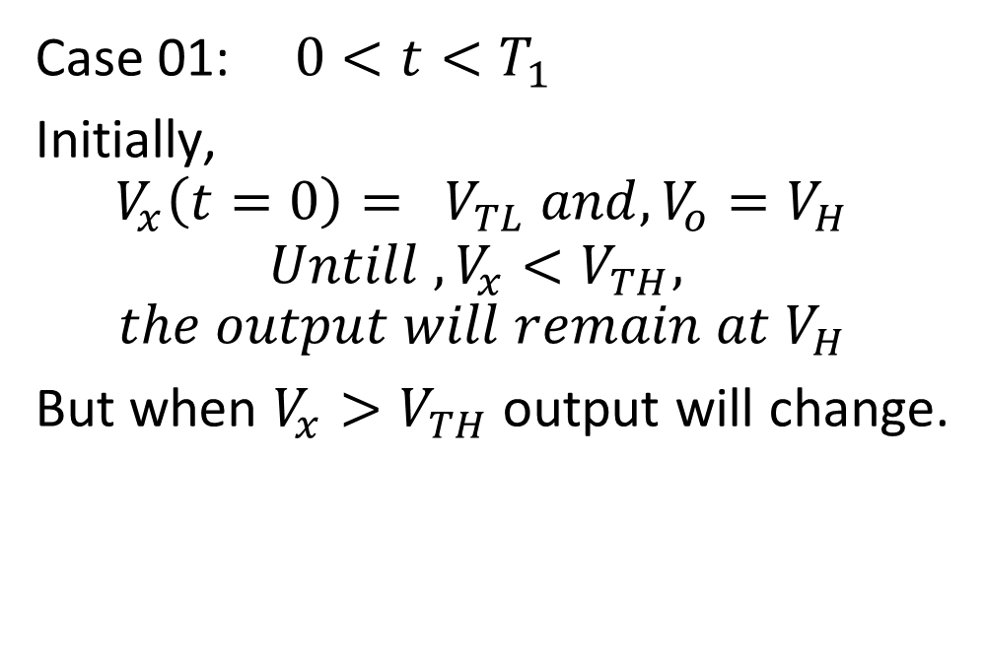
Square wave generator
Case 01:$0<t<T_{1}$
Initially,
$$V_{x}\left(t=0\right)= V_{TL} and, V_{o}=V_{H}$$
$$Untill , V_{x}<V_{TH},$$
$$the output will remain at V_{H}$$
But when $V_{x}>V_{TH}$output will change.

Slide 9
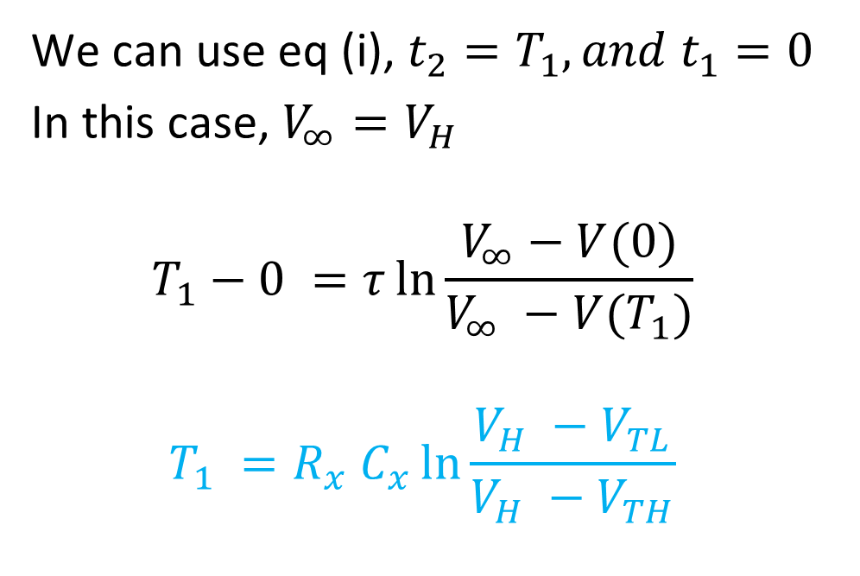
Square wave generator
We can use eq (i), $t_{2}=T_{1}, and t_{1}=0$
In this case, $V_{∞}=V_{H}$
$$T_{1}−0 =τ\ln{\frac{V_{∞}−V(0)}{V_{∞} −V(T_{1})}}$$
$$T_{1} =R_{x} C_{x}\ln{\frac{V_{H} −V_{TL}}{V_{H} −V_{TH}}}$$

Slide 10
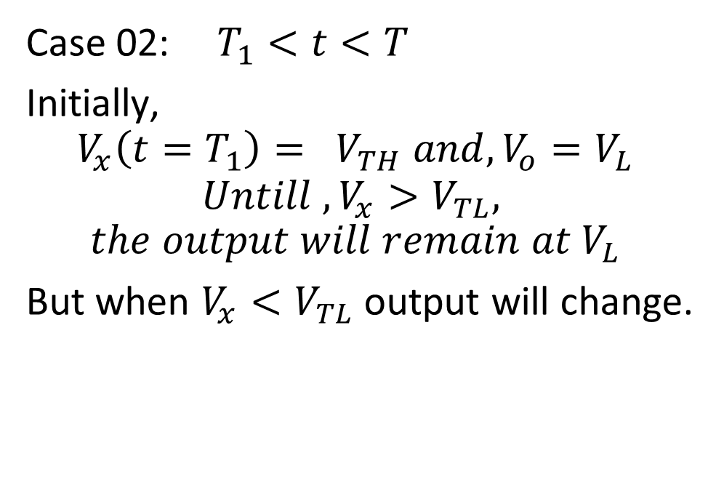
Square wave generator
Case 02:$T_{1}<t<T$
Initially,
$$V_{x}\left(t=T_{1}\right)= V_{TH} and, V_{o}=V_{L}$$
$$Untill , V_{x}>V_{TL},$$
$$the output will remain at V_{L}$$
But when $V_{x}{<V}_{TL}$output will change.

Slide 11
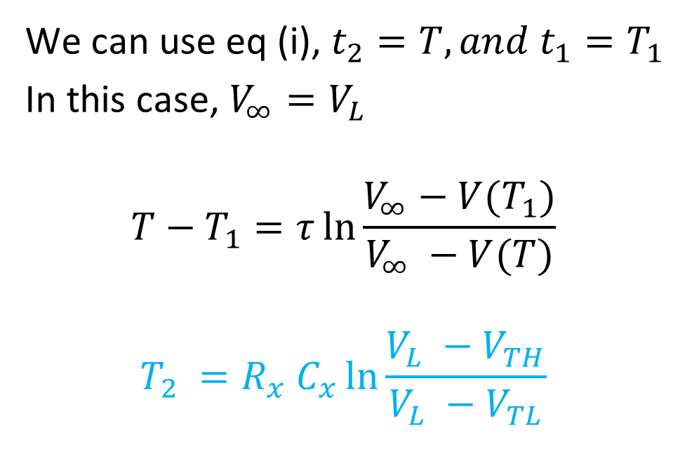
Square wave generator
We can use eq (i), $t_{2}=T, and t_{1}=T_{1}$
In this case, $V_{∞}=V_{L}$
$$T−T_{1}=τ\ln{\frac{V_{∞}−V(T_{1})}{V_{∞} −V(T)}}$$
$$T_{2} =R_{x} C_{x}\ln{\frac{V_{L} −V_{TH}}{V_{L} −V_{TL}}}$$

Slide 12

Square wave generator Formulas
$$V_{TL}=V_{L}\frac{R_{1}}{R_{1}+R_{2}} V_{TH}=V_{H}\frac{R_{1}}{R_{1}+R_{2}}$$
$$T_{2} =R_{x} C_{x}\ln{\frac{V_{L} −V_{TH}}{V_{L} −V_{TL}}} T_{1} =R_{x} C_{x}\ln{\frac{V_{H} −V_{TL}}{V_{H} −V_{TH}}}$$
$Duty cycle = \frac{T_{1}}{T_{1}+T_{2}}∗100\% or \frac{T_{1}}{T}$*100%

Slide 13
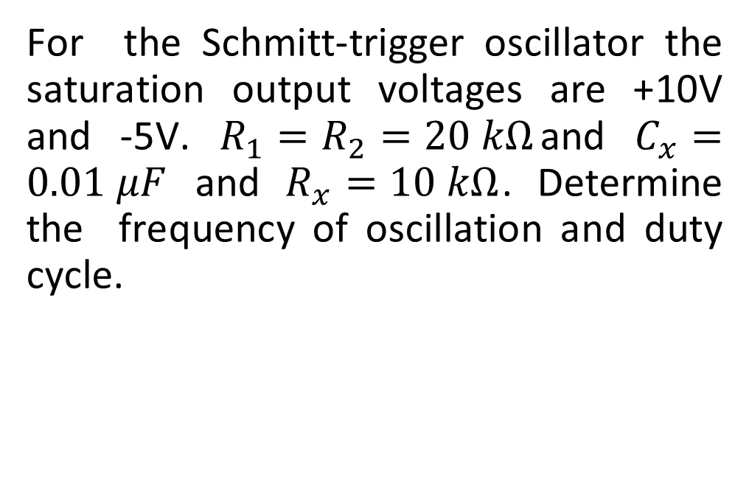
Exercise:
For the Schmitt-trigger oscillator the saturation output voltages are +10V and -5V. $R_{1}=R_{2}=20 kΩ$and $C_{x}=0.01 μF$ and $R_{x}=10 kΩ$. Determine the frequency of oscillation and duty cycle.

Slide 14
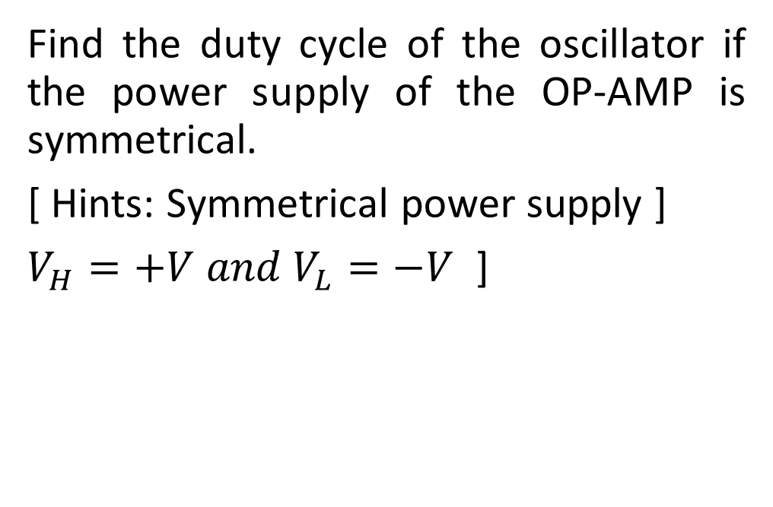
Exercise:
Find the duty cycle of the oscillator if the power supply of the OP-AMP is symmetrical.
[ Hints: Symmetrical power supply ]
$V_{H}=+V and V_{L}=−V$ ]

Slide 15
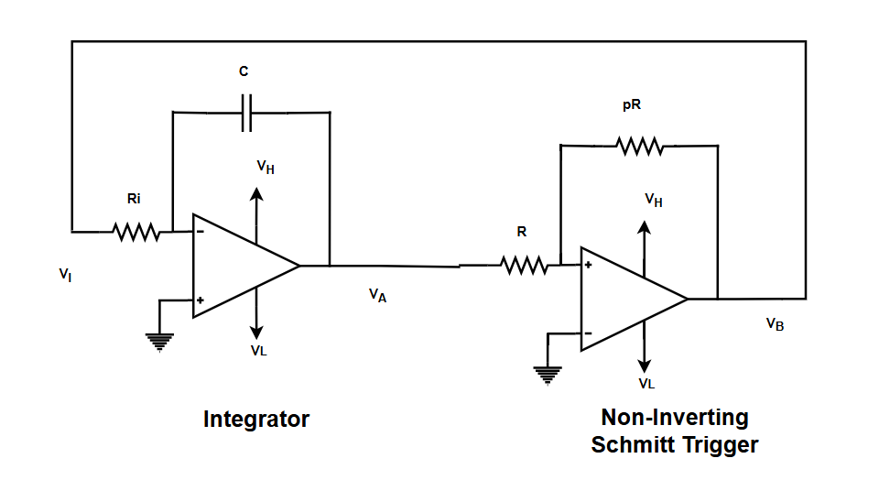
Triangular wave generator
Here is the circuit of the triangular wave generator.

Slide 16
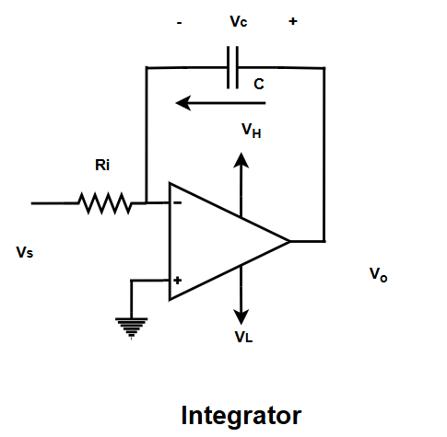
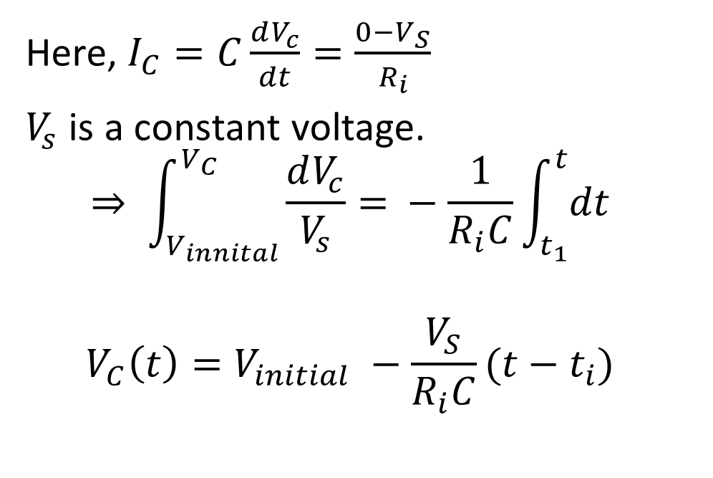
Integrator
Here, $I_{C}=C\frac{dV_{c}}{dt}=\frac{0−V_{S}}{R_{i}}$
$V_{s}$ is a constant voltage.
$$⇒ \int_{V_{innital}}^{V_{C}}{\frac{dV_{c}}{V_{s}}= }−\frac{1}{R_{i}C}\int_{t_{1}}^{t}{dt}$$
$$V_{C}\left(t\right)=V_{initial} −\frac{V_{S}}{R_{i}C}(t−t_{i})$$

Slide 17
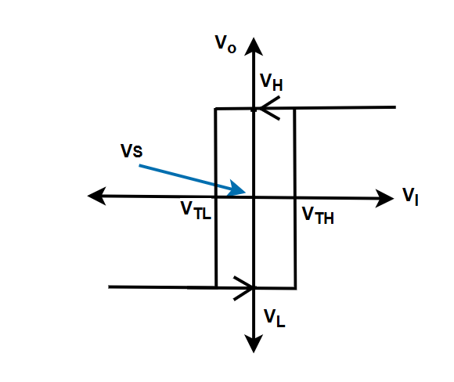
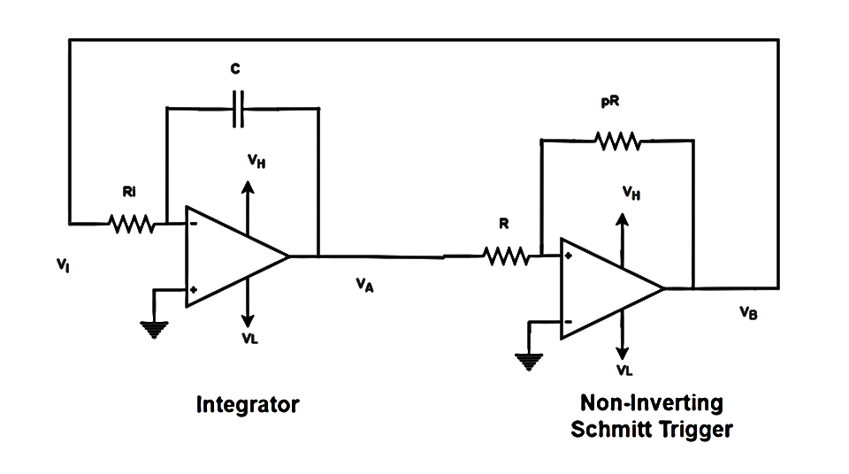
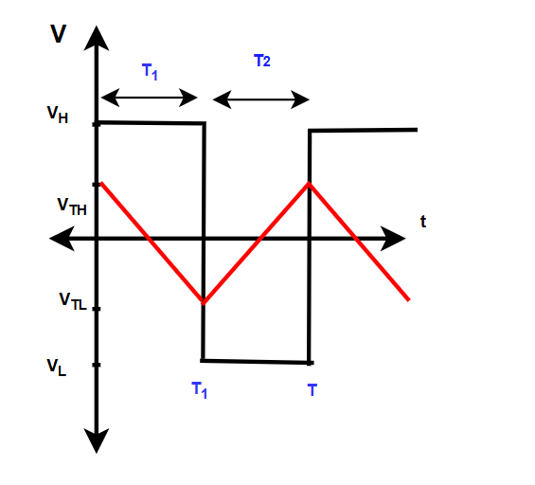
Triangular

Slide 18

Triangular
$$V_{TH}=−\frac{R_{1}}{R_{2}}V_{L} =−\frac{R}{pR}V_{L} =−\frac{V_{L}}{p}$$
$$V_{TL }=−\frac{V_{H}}{p}$$

Slide 19
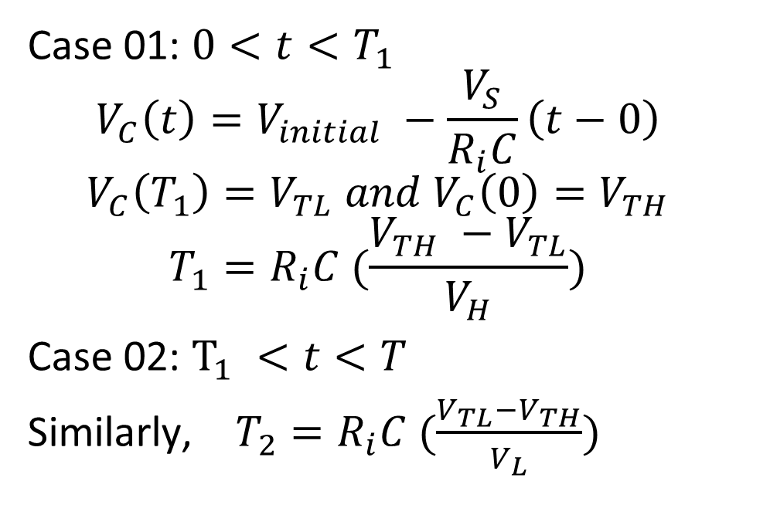
Triangular
Case 01: $0<t<T_{1}$
$$V_{C}\left(t\right)=V_{initial} −\frac{V_{S}}{R_{i}C}\left(t−0\right)$$
$$V_{C}\left(T_{1}\right)=V_{TL} and V_{C}\left(0\right)=V_{TH}$$
$$T_{1}=R_{i}C (\frac{V_{TH} −V_{TL}}{V_{H}})$$
Case 02: $T_{1} <t<T$
Similarly, $T_{2}=R_{i}C (\frac{V_{TL}−V_{TH}}{V_{L}})$

Slide 20
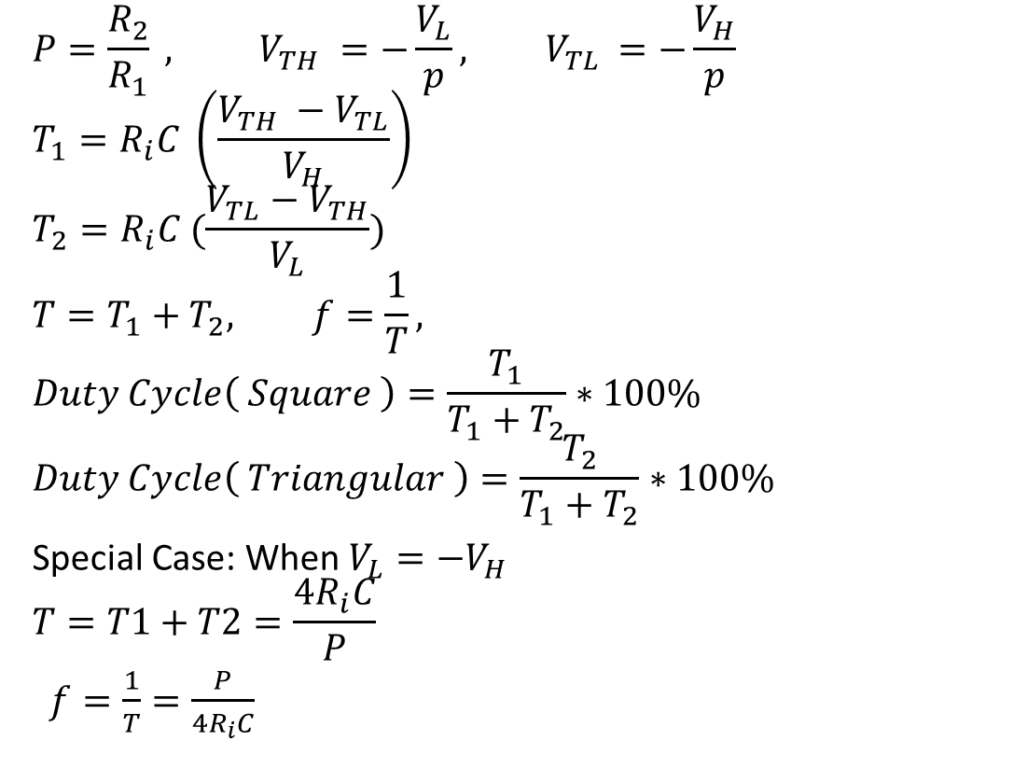
Formula of Triangular Wave
$$P=\frac{R_{2}}{R_{1}} , V_{TH} =−\frac{V_{L}}{p}, V_{TL }=−\frac{V_{H}}{p}$$
$$T_{1}=R_{i}C \left(\frac{V_{TH} −V_{TL}}{V_{H}}\right)$$
$$T_{2}=R_{i}C (\frac{V_{TL}−V_{TH}}{V_{L}})$$
$$T=T_{1}+T_{2}, f=\frac{1}{T},$$
$$Duty Cycle\left( Square \right)=\frac{T_{1}}{T_{1}+T_{2}}∗100\%$$
$$Duty Cycle\left( Triangular \right)=\frac{T_{2}}{T_{1}+T_{2}}∗100\%$$
Special Case: When $V_{L}=−V_{H}$
$$T=T1+T2=\frac{4R_{i}C}{P}$$
$f=\frac{1}{T}=\frac{P}{4R_{i}C}$
Note: $T_{1}=Falling time of triangular wave, T_{2}=Rising time of triangular wave$

Slide 21

Exercise:
Answer the following question for the Triangular wave generator.
Given, $R_{i}=10k, C=10 μF , R_{2}=pR=20k, R1=R=10k, V_{L}=−V_{H} or V_{H}=15 V, V_{L}=−15 V$
a). Draw the voltage $V_{A} and V_{B} vs t$ plot with proper labeling.
b.) Draw the VTC of the Schmitt trigger.
c.) Find the frequency, Time period, Duty cycle of the Triangular wave, Duty cycle of the Square wave.

Slide 22

Exercise:
Answer the following question for the Triangular wave generator.
Given, $R_{i}=10k, C=10 μF , R_{2}=pR=20k, R1=R=10k, V_{H}=10 V, V_{L}=−12 V$
a). Draw the voltage $V_{A} and V_{B} vs t$ plot with proper labeling.
b.) Draw the VTC of the Schmitt trigger.
c.) Find the frequency, Time period, Duty cycle of the Triangular wave, Duty cycle of the Square wave.

Slide 23
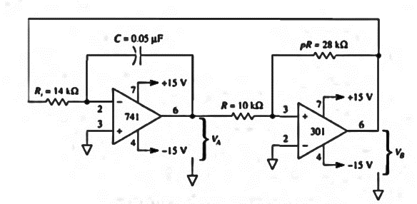
Exercise:
Draw the waveform of the following circuit and calculate the frequency and duty cycle of triangular wave.

